Slide 1
CSE 205: Digital Logic Design ROM and PLA (Ref: Chap 5, Mano, 2nd edition)
Md. Aashikur Rahman Azim
Lecturer
CSE, BUET

Slide 2
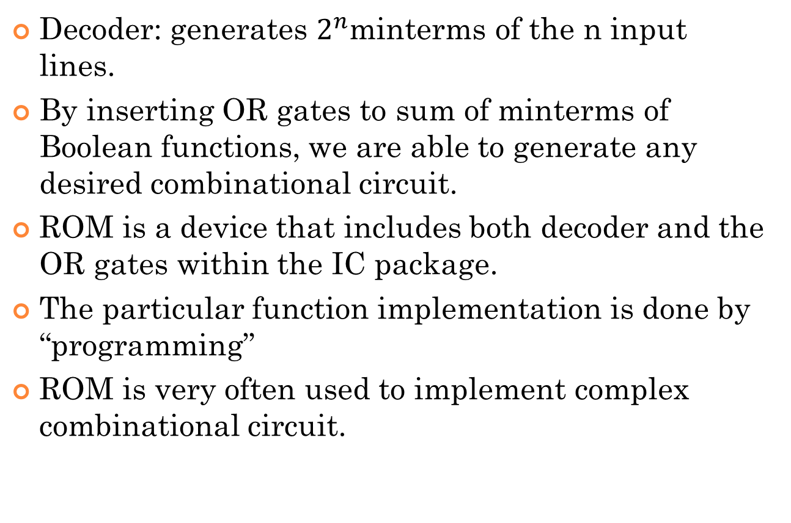
Read-only memory (rom)
Decoder: generates $2^{n}$minterms of the n input lines.
By inserting OR gates to sum of minterms of Boolean functions, we are able to generate any desired combinational circuit.
ROM is a device that includes both decoder and the OR gates within the IC package.
The particular function implementation is done by “programming”
ROM is very often used to implement complex combinational circuit.

Slide 3
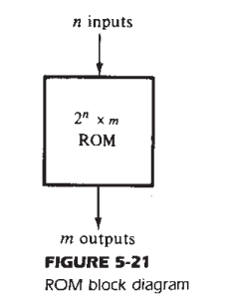
Read-only memory (rom) contd.
ROM is a memory (storage) device in which a fixed set of binary information is stored.
ROM has special internal links that can be fused or broken.

Slide 4
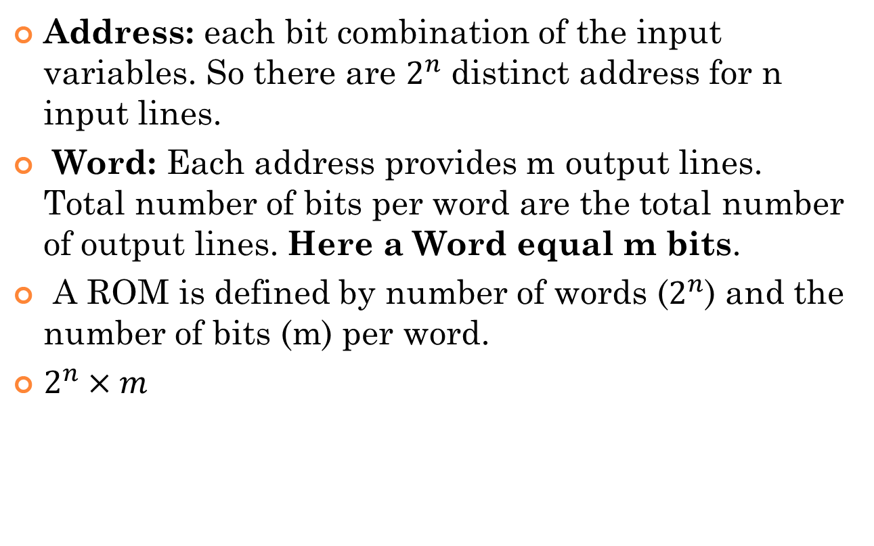
Read-only memory (rom) contd.
Address: each bit combination of the input variables. So there are $2^{n}$ distinct address for n input lines.
Word: Each address provides m output lines. Total number of bits per word are the total number of output lines. Here a Word equal m bits.
A ROM is defined by number of words ($2^{n}$) and the number of bits (m) per word.
$2^{n}×m$

Slide 5
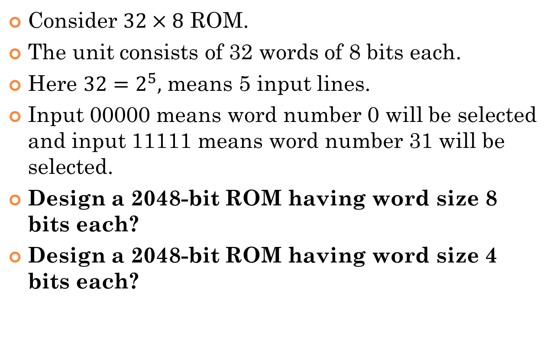
An example of a rom
Consider $32×8$ ROM.
The unit consists of 32 words of 8 bits each.
Here $32=2^{5},$ means 5 input lines.
Input 00000 means word number 0 will be selected and input 11111 means word number 31 will be selected.
Design a 2048-bit ROM having word size 8 bits each?
Design a 2048-bit ROM having word size 4 bits each?

Slide 6
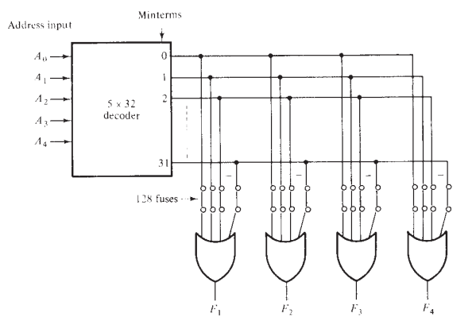

rom
$32×4$ROM: Internal logic construction.

Slide 7

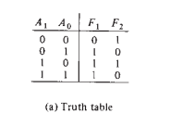

Combinational logic implementation using ROM
For an n-input, m-output combinational circuit, we need ${a 2}^{n}×m$ROM.

Slide 8
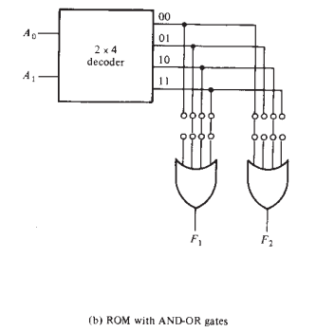
ROM with AND-OR gates

Slide 9
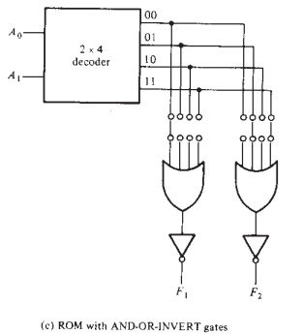
ROM with AND-OR-INVERT gates

Slide 10
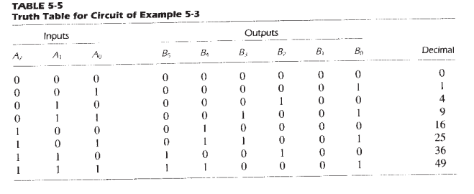
Example
Design a combinational circuit using a ROM. The circuit accepts a 3-bit number and generates an output binary number equal to the square of the input number.

Slide 11
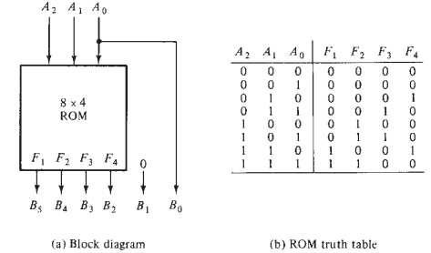
Example cont.

Slide 12
Types of ROMs
ROM may be programmed in two ways.
- mask programming
- programmable read-only memory (PROM)
Mask Programming: done by the manufacturer during the last fabrication process of the unit.
The manufacturer makes the mask for the paths to produce 1’s or 0’s according to the customers truth table.
It is economical only if large quantities of the same ROM configuration are to be manufactured.

Slide 13
Types of ROMs Contd.
PROM: It is economical for small quantities of same types of ROMs.
The links in PROM are broken by application of the current pulses through the output terminal.
An user can use his own laboratory to achieve the desired relationship between input address and stored words.
Special units called PROM programmers are available commercially to facilitate this procedure.
PROM is a hardware procedure.
So, PROM is irreversible.

Slide 14
Erasable PROM (EPROM)
EPROMs can be restructured to the initial value even though they have been changed previously.
When EPROM is placed under a special ultraviolet light for a given period time, the short-wave radiation discharges the internal gates that serve as constant.
After erasure, the ROM returns to its initial state and can be reprogrammed.
Some, ROMs can be erased with electrical signal instead of ultraviolet light. These are called electrically alterable ROMs (EAROMs)

Slide 15
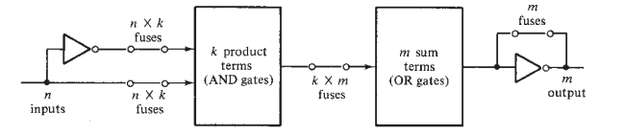
Programmable Logic Arrays (PLAs)
Pre-fabricated building block of many AND/OR gates
An array of programmable AND gates
can generate any product terms of the inputs
An array of programmable OR gates
can generate the sums of the products

Slide 16
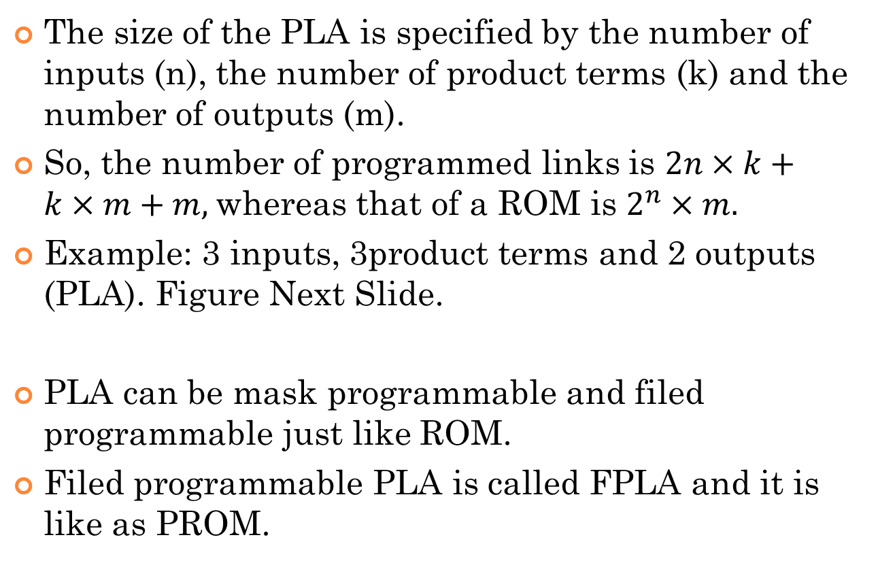
PLA Contd.
The size of the PLA is specified by the number of inputs (n), the number of product terms (k) and the number of outputs (m).
So, the number of programmed links is $2n×k+k×m+m,$whereas that of a ROM is $2^{n}×m.$
Example: 3 inputs, 3product terms and 2 outputs (PLA). Figure Next Slide.
PLA can be mask programmable and filed programmable just like ROM.
Filed programmable PLA is called FPLA and it is like as PROM.

Slide 17
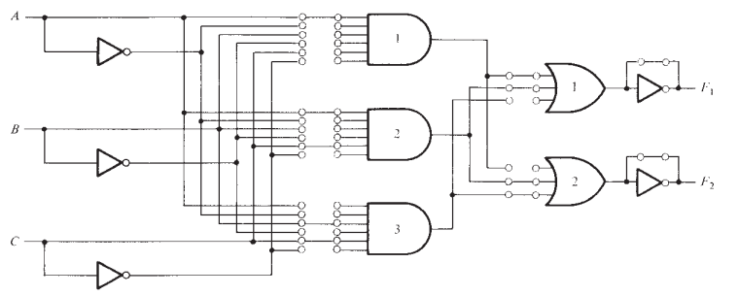
PLA Contd.

Slide 18
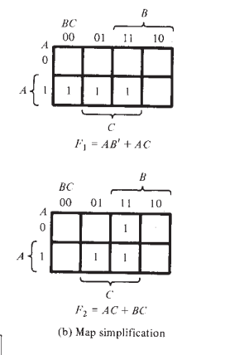
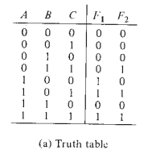
PLA Example
Consider the following combinational circuit as a truth table.

Slide 19

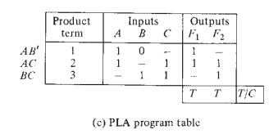
PLA Example Contd.
T: if output inverter is to be bypassed
C: For complement

Slide 20
PLA Example Contd.

Slide 21
Designing a digital system with a PLA
Reduce the number of distinct product terms
The number of literals in a product is not important

Slide 22

Example
A combinational circuit is defined by the functions:
Implement the circuit with a PLA having three inputs, four product terms and two outputs.

Slide 23

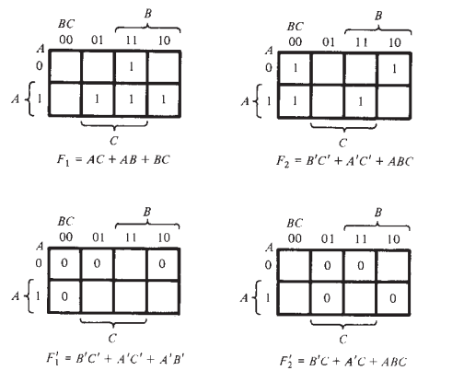
Example Contd.

Slide 24
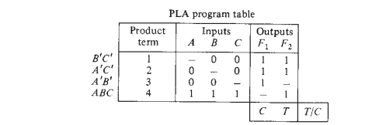
Example Contd.

Slide 25
Summary
ROM
Types of ROMs
PLA
Types of PLA
Design using ROM and PLA
Basic difference between PLA and ROM

Slide 26
Thank You

